Slide 1
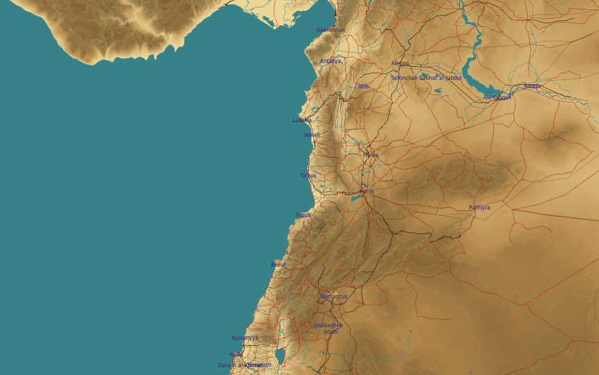
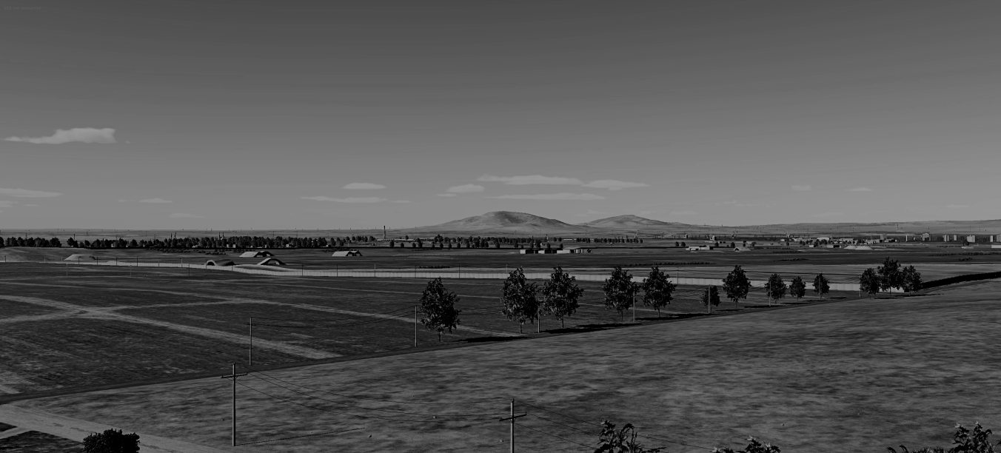
SYTGT044 Hama Airbase
N
44
WEAPONEERING:
DPI1: Primary fuel storage, 1x 500 Ibs bomb
DPI2: Secondary fuel storage, 1x 500 Ibs bomb
DPI3: Ammo storage, 1x 1000 Ibs bomb
DPI4: Ammo storage, 1x 1000 Ibs bomb
DPI5: Runway crossing , 1x 500/1000/2000 Ibs bomb
DPI6: Runway crossing , 1x 500/1000/2000 Ibs bomb
DPI7: Runway crossing , 1x 500/1000/2000 Ibs bomb
DPI8: Runway crossing , 1x 500/1000/2000 Ibs bomb
HAMA Airbase: The target complex is supported by 2 fuel storages and 2 ammo storages.

Slide 2
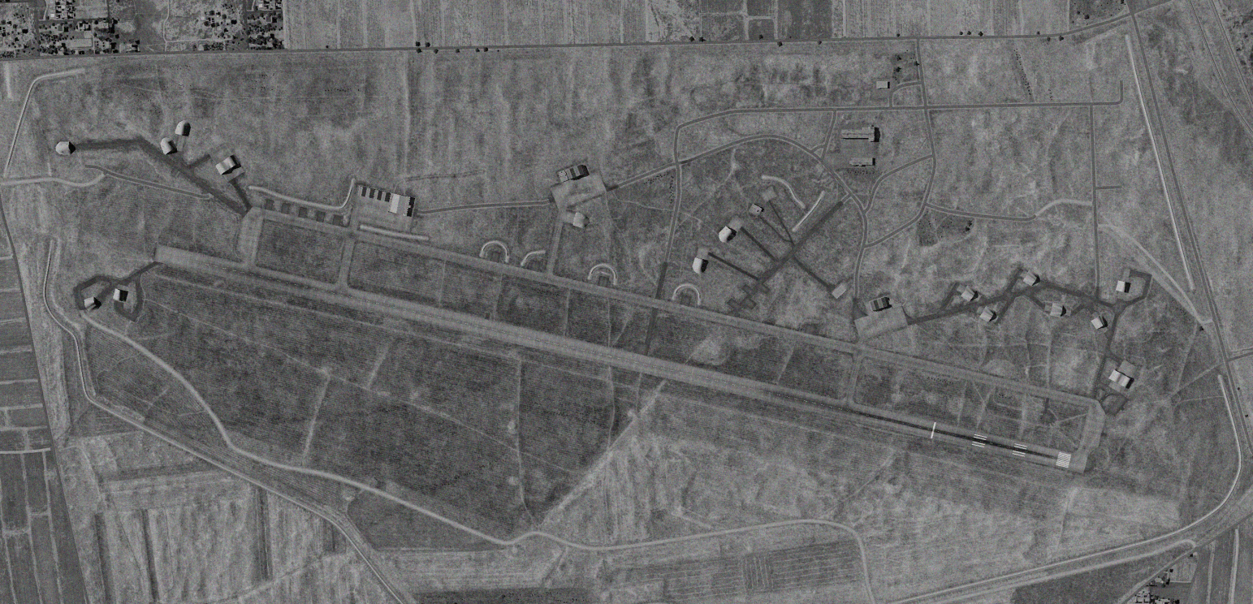
SYTGT044 Hama Airbase
DPI’s relate to centre points of targets:
DPI1: N35 7.558 E036 43.103, 968ft
DPI2: N35 7.090 E036 43.627, 984ft
DPI3: N35 7.477 E036 43.067, 962ft
DPI4: N35 7.433 E036 43.080, 966ft
DPI5: N35 7.193 E036 41.915, 984ft
DPI6: N35 7.166 E036 42.096, 984ft
DPI7: N35 7.090 E036 42.681, 984ft
DPI8: N35 6.981 E036 43.550, 984ft
All coordinates TLE CAT 1.
N
1
2
3
5
6
7
4
8

Slide 3
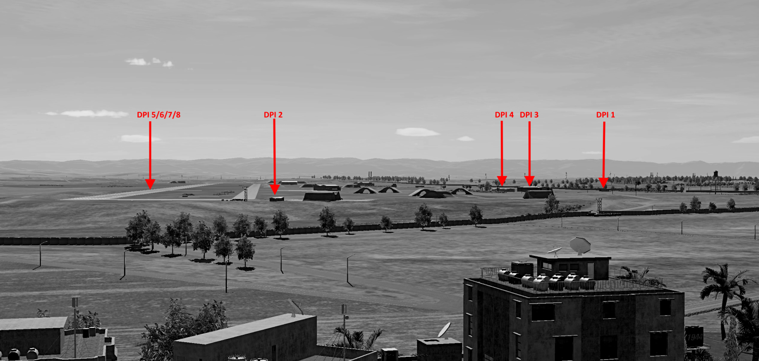
SYTGT044 Hama Airbase
HUMINT Hama airbbase
N
7
8

